Slide 1
HOME SECURITY AND INTRUDER DETECTION MANAGEMENT
Presented by: Guided by:
B.Aakash Raj ( 310517104001 ) Mrs.Muthupandeeswari M.E
M.Arun ( 310517104017 )
C.HariHaran ( 310517104040 )
S.Jayachandhiran ( 310517104047 )

Slide 2
What is IOT?
Internet Of Things is shortly Known as IOT.
Network of physical object are embedded with sensors, software and other technologies.
IOT was the most important development in 21 century.

Slide 3
ABSTRACT
This project is designed to develop a home security system based on Raspberry Pi.
Which realizes the function of providing residence with security and information through remote sensing.
To complete this project, team members use PIR sensor to detect the motion information of a house .
In order to ensure that the owner can get the potential unusual or dangerous situations in time, security notifications will be by email and Through SMS.
The goal of this project is to replace the current DLINK security system with a system that does not need to go out to the cloud for information sharing and control.

Slide 4
EXISTING SYSTEM
In the present existing system, the CCTV camera captures video and stores it in the memory of the computer.
For reference the user can view the video but it is a boring process.
In the CCTV system, I need a dedicated PC for this module that is eliminated in the Raspberry pi module.

Slide 5
DRAWBACKS
In this existing system we couldn’t monitor the power supply 24X7.
Less security in it.
It has limited storage.

Slide 6
PROPOSED SYSTEM MECHANISM
It provide essential security to our homes and for other control applications.
The proposed home security system captures information and transmits to respective mail and alert will send by SMS to the Owner.
Raspberry pi operates and controls motion detectors and video cameras for remote sensing and surveillance, streams live video and records it for future playback.
It can also find the number of persons located with the help of the Infrared sensor.
When motion is detected, cameras automatically start recording and the Raspberry pi device alerts the owner of the possible intrusion through mail.
Finally captured video will convert into mp4 then it will automatically send to the owner mail.

Slide 7
ADVANTAGES
Secured with end-end encryption.
Captured data automatically transferred to mail.
Work when the intrusion detected otherwise system will not waste the power.
Low cost portable device.

Slide 8
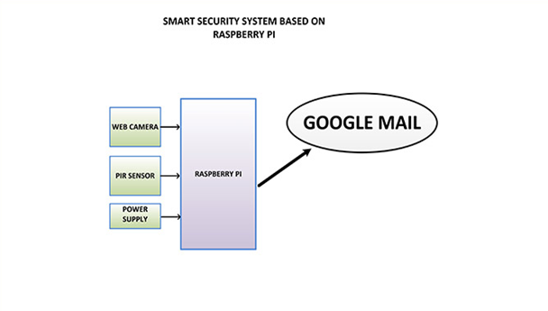
ARCHITECTURE

Slide 9
REQUIREMENTS
Hardware:
Raspberry pi 4 with bootable raspbian OS
Pi camera
PIR sensor
Software:
Python IDE 3.7
Raspbian OS

Slide 10
LITERATURE SURVEY
Sushma .N. Nichal, Prof. J.K. Singhhas done abstraction of Smart supervisor system using IOT based on embedded Linux O.S. with ARM11 architecture.
In this Paper they have implemented real-time video monitoring system and acquired data.
In this system they have also used PIR, temperature, Humidity sensors the system first requires authentication from user to activate the system if the system detect human it will send that data to the server or user smart phone.

Slide 11
Sowmiya. U, Shafiq Mansoor. J. Have developed to connect any door with internet, in this system user also implemented PIR sensor and camera.
PIR sensor used for detecting person and camera used for capturing the video of person comes at door.
The video will be send through 3g dongle to authorized person. They have also discussed some advantages of this system.
They have concluded use of this system like bank, hospital etc.

Slide 12
BACKGROUD SUBTRACTION ALGORITHM
Background subtraction is a mainstream algorithm for moving object detection in video surveillance system.
It segments moving objects by using the difference between the background and input images.
The key to background subtraction is to establish a reliable initial background.

Slide 13
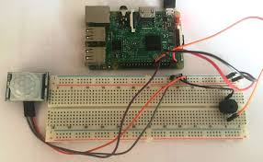
BACKGROUD

Slide 14
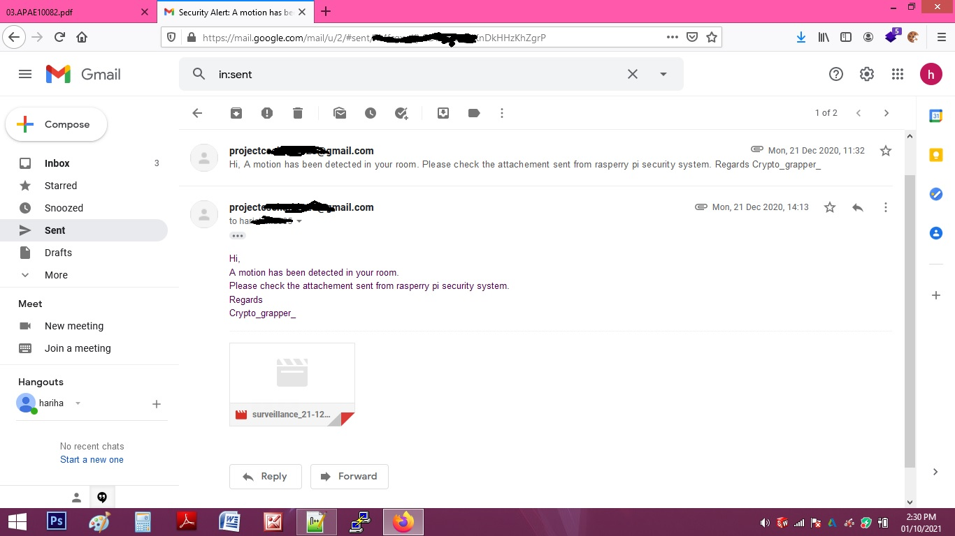
MAIL RESULT

Slide 15
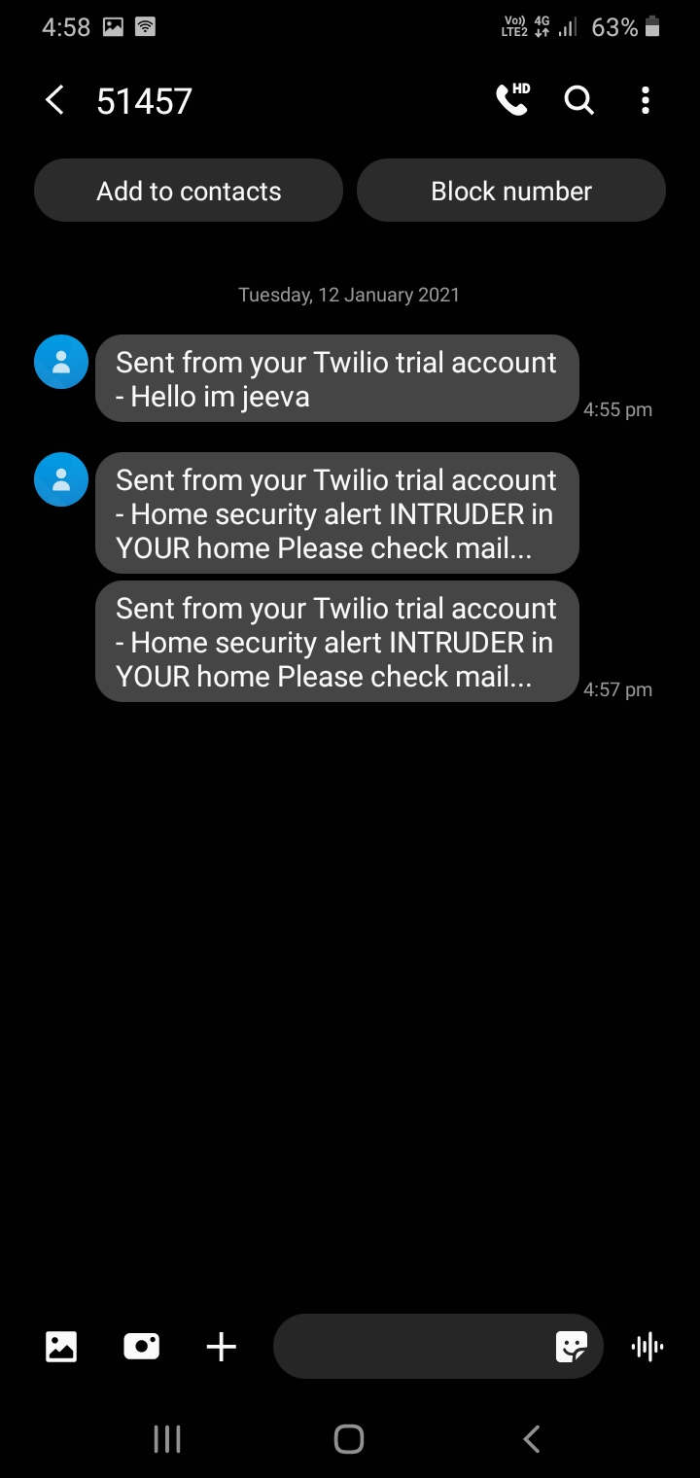
SMS

Slide 16
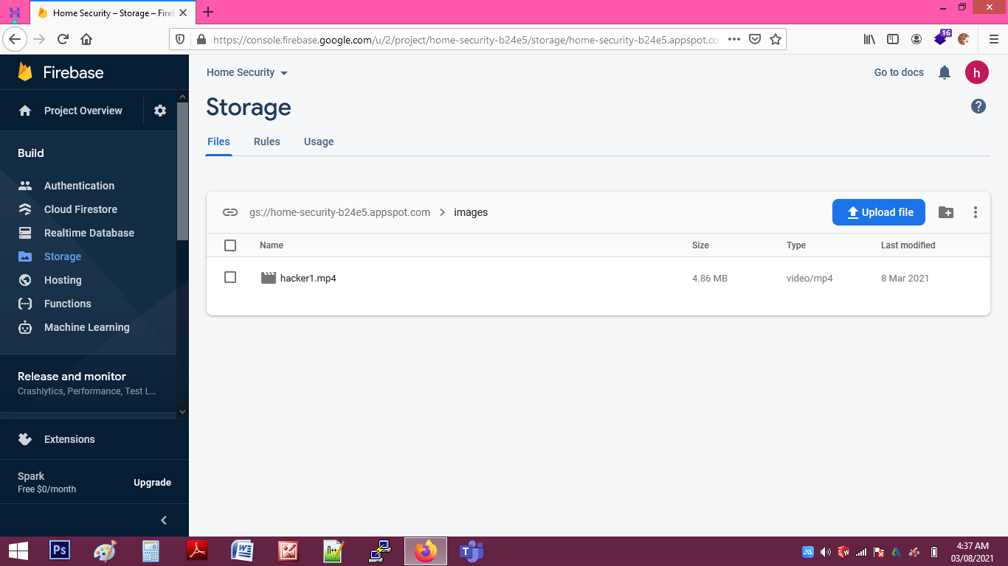
FIREBASE DATA STORAGE

Slide 17
CONCLUSION
Thus we have designed a smart surveillance system capable of capturing video and transmitting to Email and alert will send to mobile SMS.
It offers reliability and privacy on both sides.
It is portable because of using mobile technology and mailing protocol to transmit the data’s .

Slide 18
REFERENCE
[1]. R. Rani, S.Lavanya, B.Poojitha, “IoT Based Home Security System Using Raspberry Pi with Email and Voice Alert” International Journals of Advanced Research in Computer Science and Software Engineering ISSN: 2277-128X (Volume-8, Issue-4), April 2018, pp. 119-123.
[2]. Ruby Dinakar, Deepthi U Singh, Mir Mohammed Abbas, Mir Riya Alex, Abhishek Yadav , “IOT Based Home Security System Using Raspberry Pi”, International Journal of Innovative Research in Computer and Communication Engineering, Vol. 6, Issue 4, April 2018, pp. 3835-3842.
[3]. Shreeyash Ghodke, Pushkar Chaudhari, Neha Chumbalkar, Arpit Gupta, Shilpa Lambor, “IOT Based Home Security System Using Raspberry Pi”, Vol. 6, Issue 12, December-2017, pp. 22830-22835.
[4]. Shaik Anwar,D.Kishore., “IOT based Smart Home Security System with Alert and Door” International Journal of Engineering Research & Technology, ISSN: 2278-0181,Vol. 5 Issue 12, December-2016,pp 504-509

Slide 19
THANK YOU !!!

